Slide 1
Shipment Logistics Analysis
CAPSTONE PROJECT
Presented By:
1. Aayush Kantak-Yashashwi IIMS-MCA

Slide 2
OUTLINE
Problem Statement (Should not include solution)
Proposed System/Solution
System Development Approach (Technology Used)
Result
Conclusion
Future Scope
References

Slide 3
Problem Statement
Example: Analyze sales data including Order ID, dates, shipping details, country, region, sales figures, and categories to optimize shipping schedules, identify regional sales trends, and assess product category contributions. Aim to improve shipping efficiency, understand regional sales dynamics, and enhance strategic decision-making based on data insights.

Slide 4
Proposed Solution
Data Completeness:
All columns except for Postal Code have complete data.
Postal Code has 11 missing values.
Statistical Summary:
The Sales column has a wide range with a minimum value of 0.44 and a maximum value of 22,638.48. The average sale is 230.77.
Data Types:
The dataset contains a mix of integer, float, and object data types.
Date columns are currently stored as objects and may need to be converted to datetime format for analysis.
Contd..

Slide 5
Proposed Solution
Data Preprocessing:
Convert Order Date and Ship Date to datetime format.
Handle missing values in Postal Code.
Check for any duplicate rows and remove if necessary.
Exploratory Data Analysis (EDA):
Analyze the distribution of numerical features like Sales.
Explore relationships between features, e.g., sales by Category, Region, Ship Mode.
Visualize data to identify patterns or trends.
Feature Engineering:
Create new features if needed, e.g., shipping duration by calculating the difference between Order Date and Ship Date.

Slide 6
System Approach
Data Preprocessing:
Load Data: Load the dataset and examine its structure.
Handle Missing Values: Identify and fill or remove missing values.
Convert Data Types: Convert date columns to datetime format.
Remove Duplicates: Identify and remove duplicate rows if any.
Exploratory Data Analysis (EDA):
Sales Distribution: Visualize the distribution of sales.
Feature Analysis: Analyze the impact of different features on sales.
Correlation Analysis: Identify correlations between features and sales.
Feature Engineering:
Shipping Duration: Create a feature for shipping duration.
Encoding: Encode categorical variables.
Scaling: Scale numerical features if necessary.

Slide 7
Algorithm & Deployment
Date Conversion:
Order Date and Ship Date columns have been successfully converted to datetime format.
Missing Values:
Missing values in the Postal Code column were filled with mean values or we can simply replace it with 0.
There are now no missing values in the dataset.
Duplicates:
No duplicate rows were found in the dataset.
Contd..

Slide 8
Algorithm & Deployment
Next Steps: Exploratory Data Analysis (EDA)
Let's perform some exploratory data analysis to gain insights:
Sales Distribution:
Analyze the distribution of the Sales column.
Sales by Category:
Analyze sales by product category.
Sales by Region:
Analyze sales by region.
Sales by Segment:
Analyze sales by customer segment.
Shipping Duration:
Calculate and analyze the shipping duration.

Slide 9
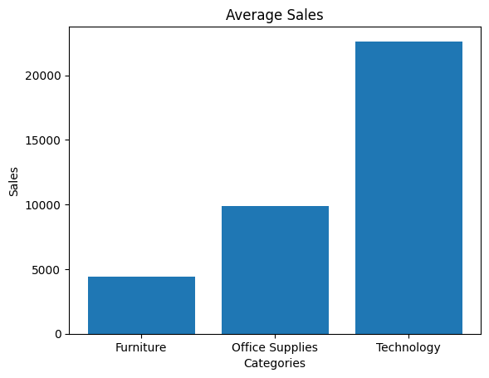
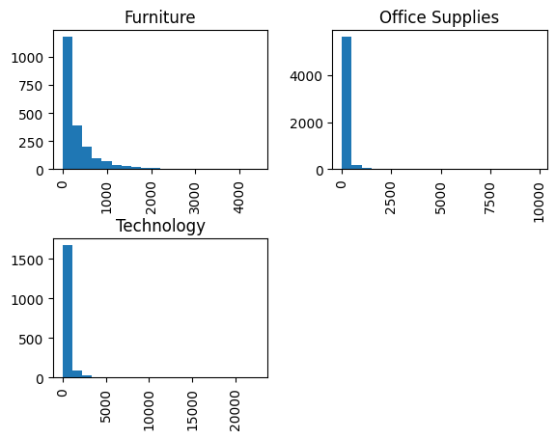
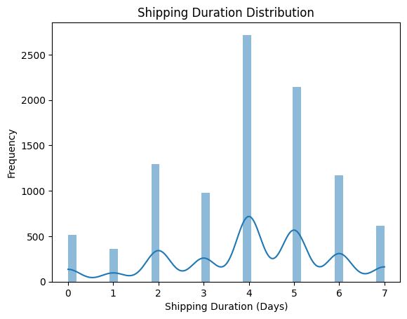
Result

Slide 10
project link (GitHub, google drive)
GitHub Link: Shipment Logistics Analysis
GitHub Repo: IBM Project
CSV File Link: train.csv

Slide 11
Conclusion
Summary
Sales Distribution:
The distribution of Sales is highly skewed with a large number of small transactions and a few very high-value transactions.
Sales by Category:
Sales in the Technology category have the highest variability with some very high sales.
Furniture and Office Supplies also show variability, but not as high as Technology.
Sales by Region:
Sales in the West region tend to be higher, with the South region showing the lowest median sales.
The Central and East regions have similar distributions with moderate variability.
Sales by Segment:
The Corporate segment has the highest variability in sales.
The Consumer and Home Office segments have similar distributions with moderate sales.
Shipping Duration:
Most orders are shipped within 3-5 days.
The average shipping duration is approximately 4 days, with a maximum of 7 days.

Slide 12
Future scope
Future Scope for Predicting Sales Model -
Improvement and Optimization:
Advanced Feature Engineering:
Incorporate additional features such as promotions, discounts, and seasonal effects.
Model Selection and Tuning:
Explore advanced machine learning algorithms such as XGBoost, LightGBM, and neural networks.
Use hyperparameter tuning techniques like Grid Search and Random Search to optimize model performance.
Scalability and Real-Time Predictions
Deployment on Cloud Platforms:
Deploy the model on cloud platforms like AWS, Google Cloud, to handle large-scale data and provide scalable solutions.
Real-Time Prediction Systems:
Implement real-time prediction systems to provide immediate sales predictions based on new order data, helping in dynamic decision-making.

Slide 13
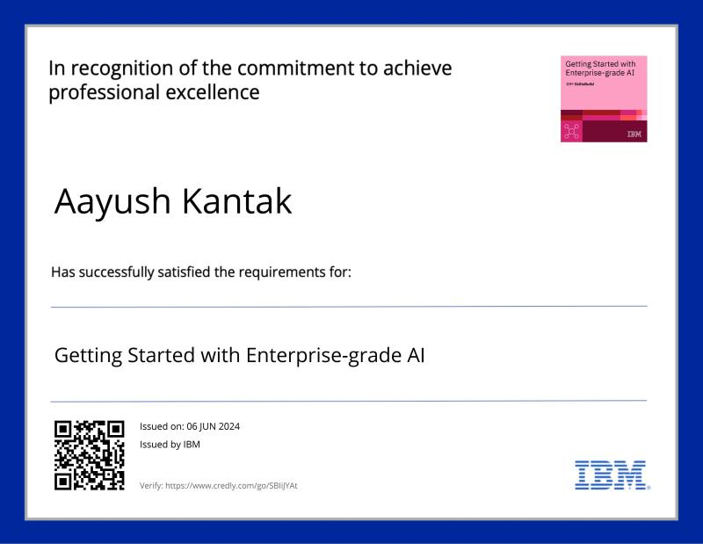
course certificate 1

Slide 14

course certificate 2

Slide 15
THANK YOU

